Slide 1
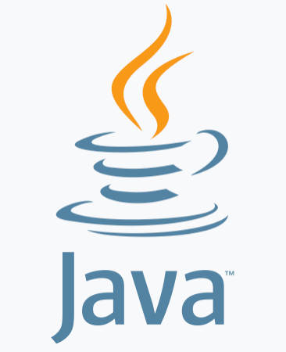
Introduction to Java Programming
Sandeep Maloth
Java developer and coach
Notes:
First Class: Introduction, Prerequisites, Advices, Syllabus
Lab 1: Create a Java Project, Compile, and Run.
Show syntax errors
Print program
Capture screen shots, and save it in Word, and print it.
Homework One: Check in the class randomly.

Slide 2

Objectives
Create, compile, and run Java programs
Primitive data types
Java control flow
Methods
Arrays
Object-oriented programming
Core Java classes ( exception, multithreading, I/O, networking, Java Collections Framework)
‹#›

Slide 3
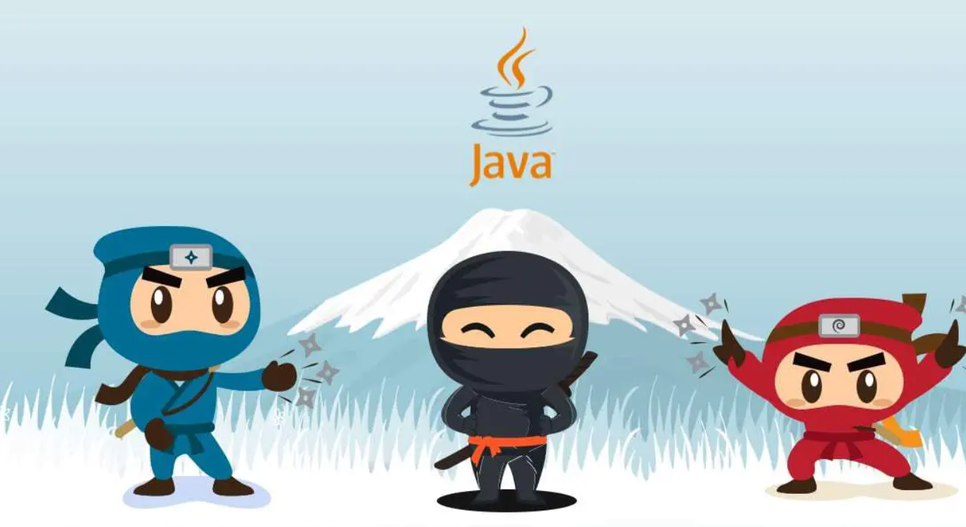
Course Objectives continued..
You will be able to
Develop programs
Write simple programs using primitive data types, control statements, methods, and arrays.
Create and use methods
Develop basic Object oriented programs
Write interesting projects
Establish a firm foundation on Java concepts
‹#›

Slide 4
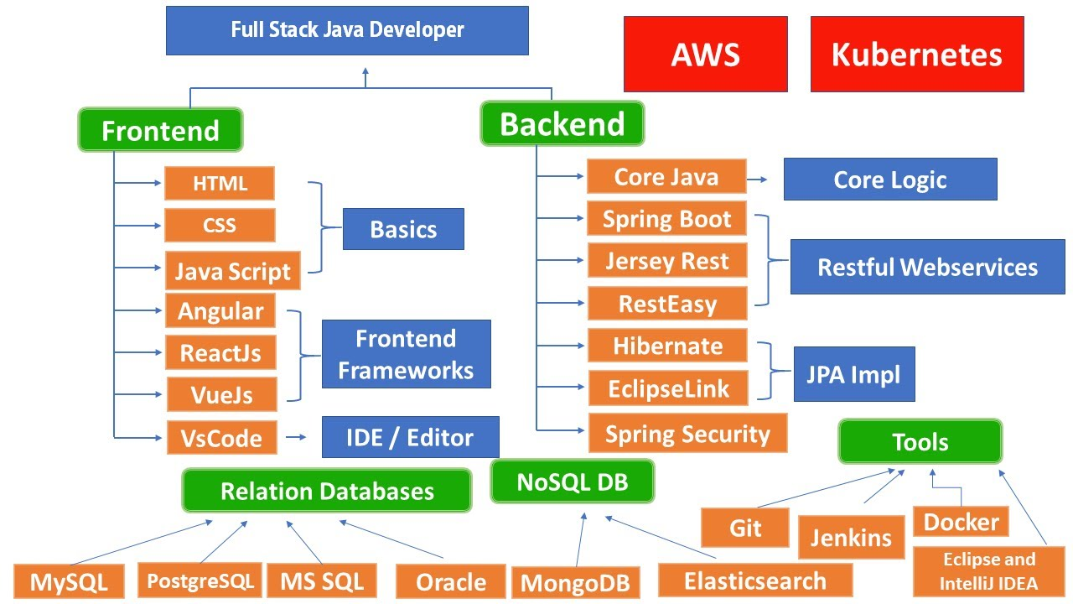
Java career path

Slide 5
Fundamentals of Programming
Introduction to Java
Primitive Data Types and Operations
Control Statements
Methods
Arrays
‹#›

Slide 6
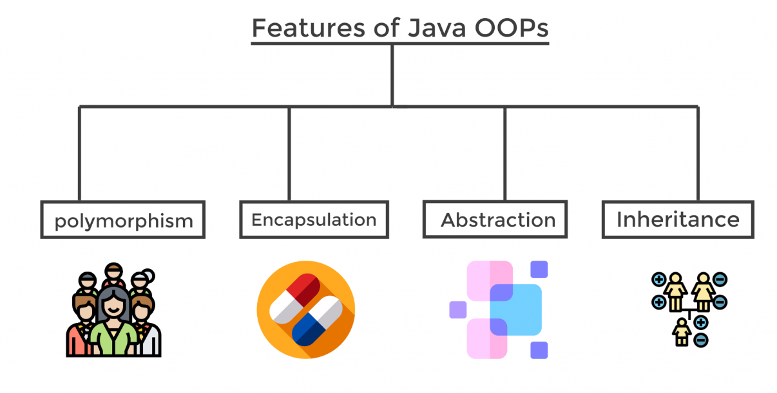
Object-Oriented Programming
Objects and Classes
Strings
Class Inheritance and Interfaces
Object-Oriented Software Development
‹#›

Slide 7
Advanced features
Exception Handling
Internationalization
Multithreading
Multimedia
Input and Output
Networking
Java Collections
‹#›

Slide 8
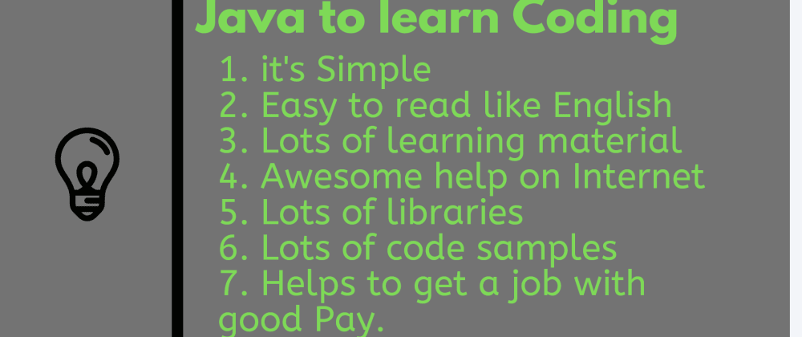
Introduction to Java and IDE
What Is Java?
Getting Started With Java Programming
Create, Compile and Running a Java Application
‹#›

Slide 9
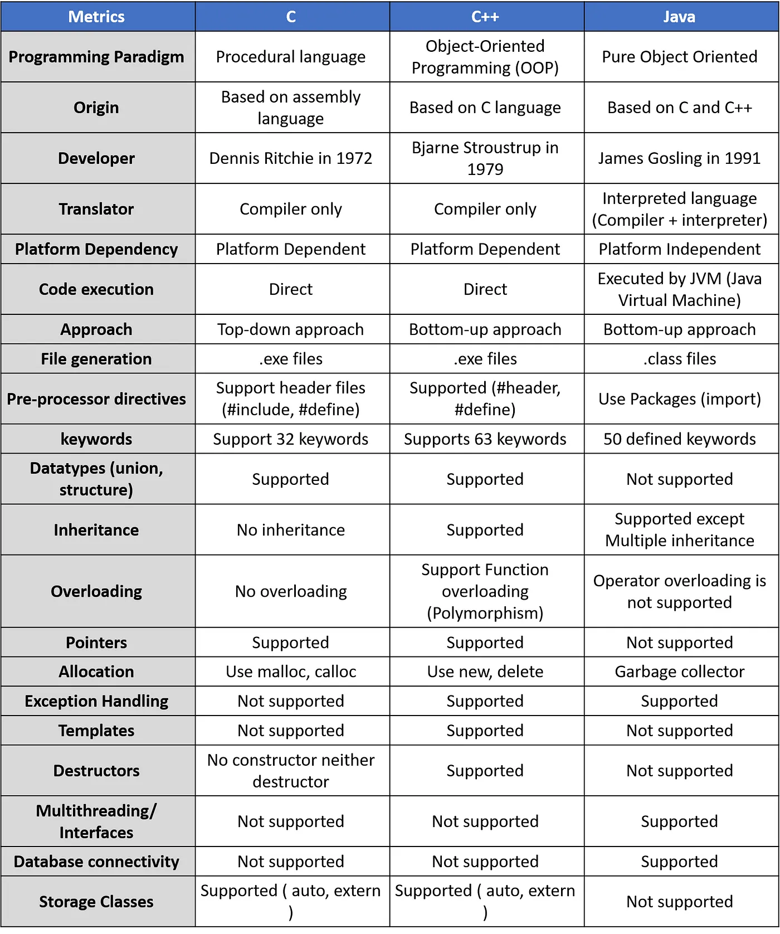
JAVA vs C, C++

Slide 10
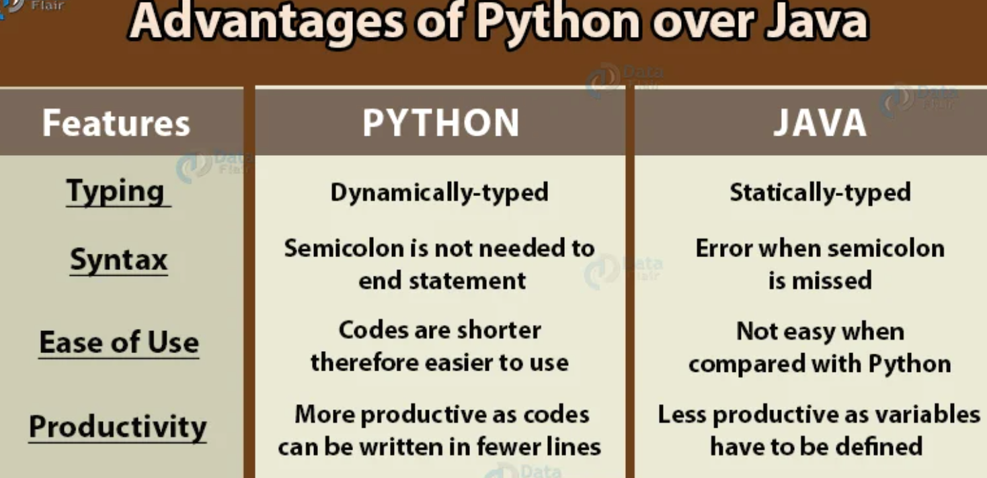
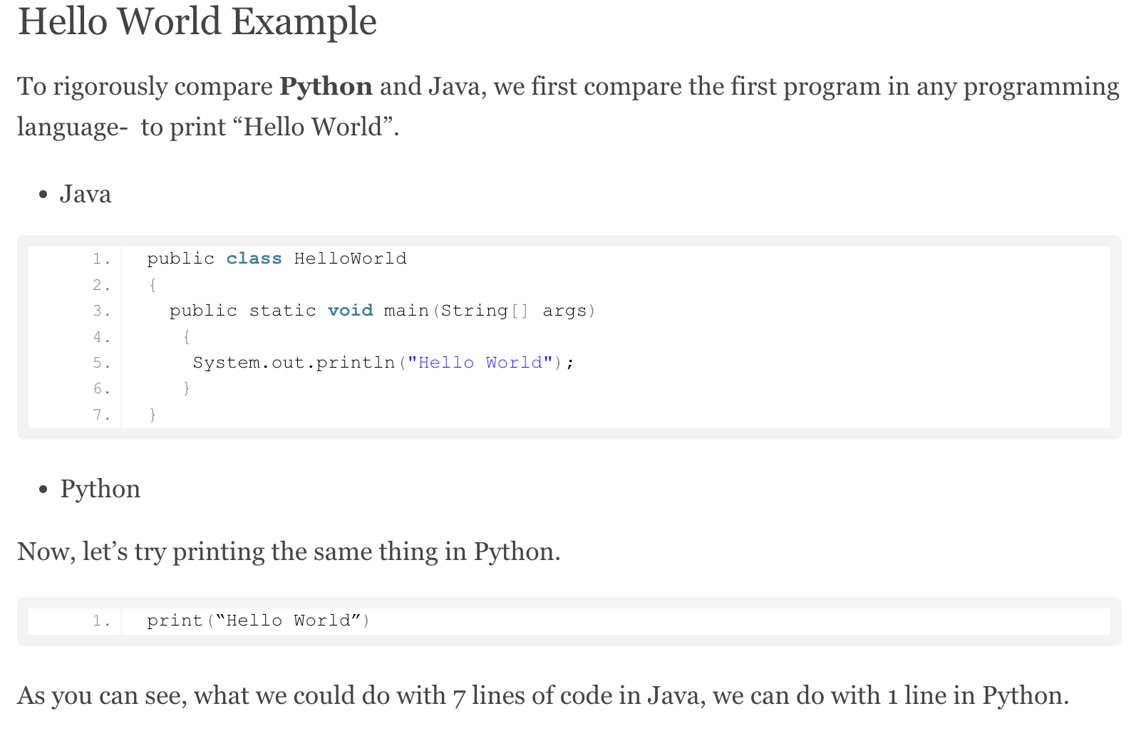
Java vs Python

Slide 11
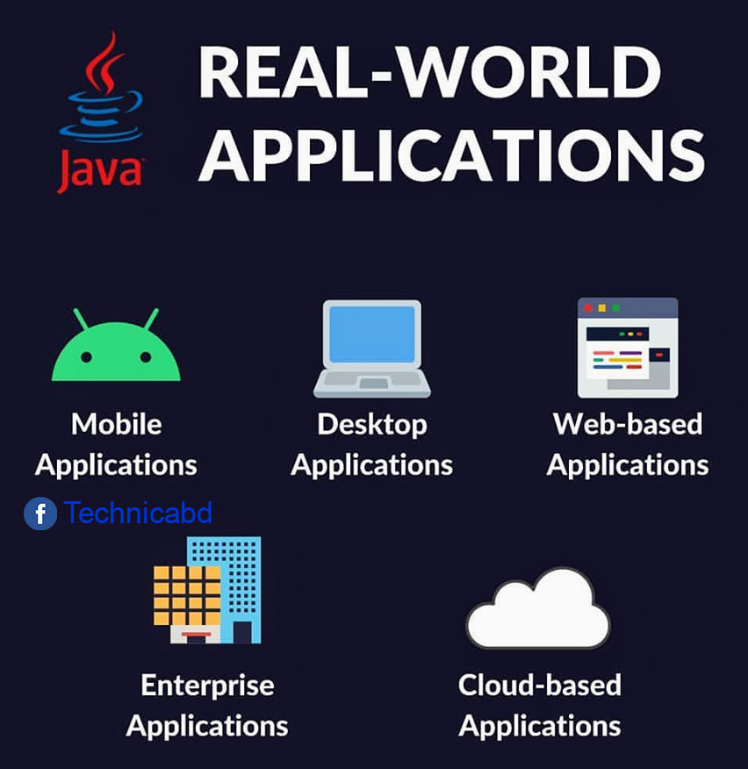

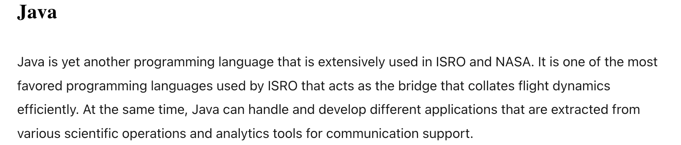
JAVA APPLICATIONS

Slide 12
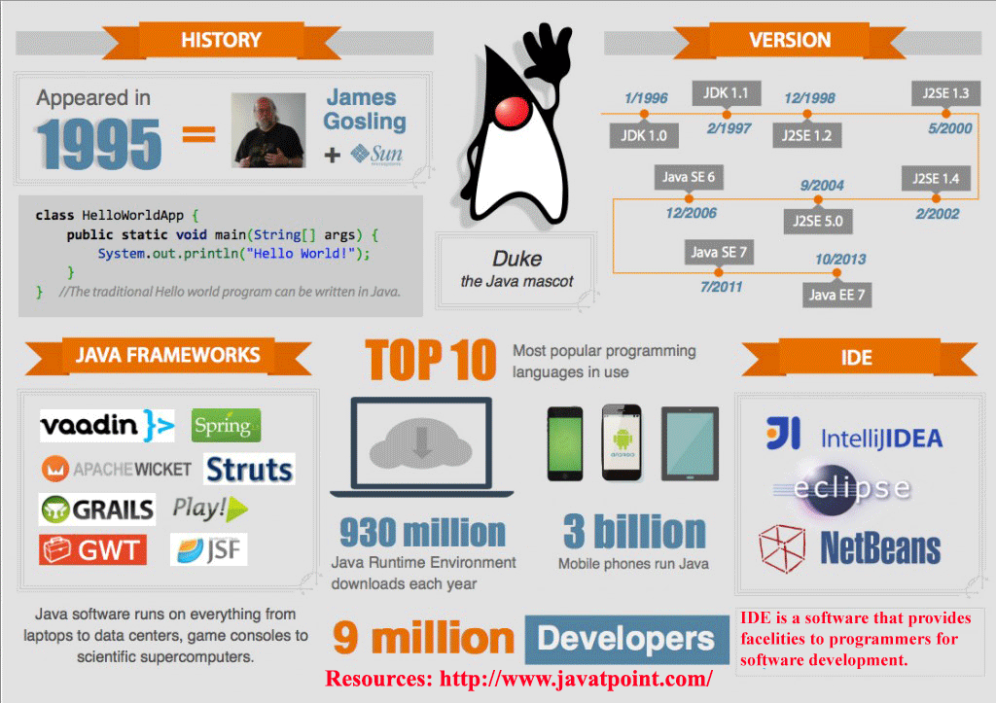
History
James Gosling and Sun Microsystems
Oak
Java, May 20, 1995, Sun World
JDK Evolutions - Version 1.0, 1.2,.. 5, 8, 11, 15, 21 ..
J2SE, J2ME, and J2EE
Oracle owns Java
More details here
‹#›

Slide 13
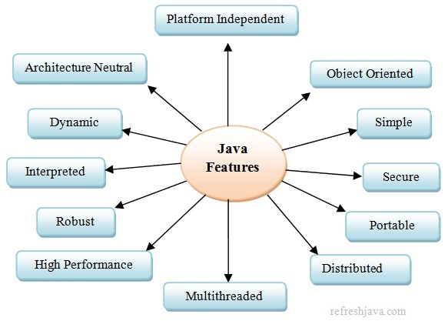
Features of Java
‹#›

Slide 14
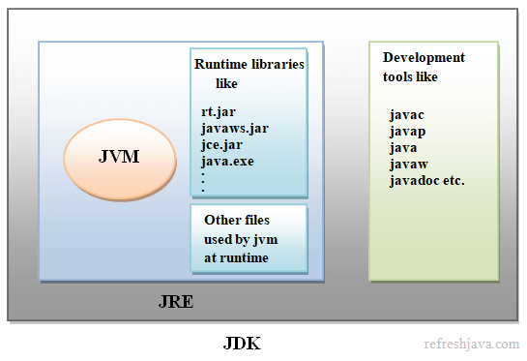
JDK, JRE, JVM …. refer

Slide 15
JDK Editions
Java Standard Edition (J2SE)
J2SE can be used to develop client-side standalone applications or applets.
Java Enterprise Edition (J2EE)
J2EE can be used to develop server-side applications such as Java servlets and Java ServerPages.
Java Micro Edition (J2ME).
J2ME can be used to develop applications for mobile devices such as cell phones.
‹#›

Slide 16
Java Programming
A Simple Java Application
Compiling Programs
Executing Applications
Debugging
‹#›

Slide 17
Java IDE Tools
IntelliJ
Eclipse
Simplify compile, run and debug a program
1
Eclipse IDE for Enterprise Java and Web Developers
https://www.eclipse.org/downloads/packages/release/2023-06/r/eclipse-ide-enterprise-java-and-web-developers
File >> New project >> Project name : CoreJava
2
JDK 8 from oracle
https://www.oracle.com/java/technologies/javase/javase8u211-later-archive-downloads.html
java --version
‹#›

Slide 18
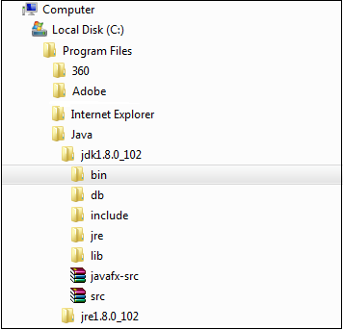
Environment setup
Install JDK 1.8
Install IDE - Eclipse or IntelliJ
Setting up the classpath refer
Checking Java installation (java –version) refer

Slide 19
A Simple Application
package com.basic;
public class MyFirstProgram {
public static void main(String[] args) {
System.out.println("Hello World");
}
}
Run
‹#›

Slide 20
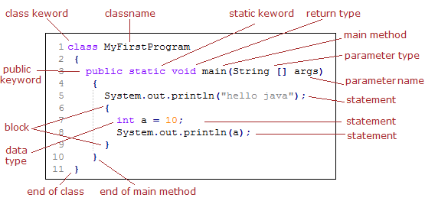
Basic terms in Java

Slide 21
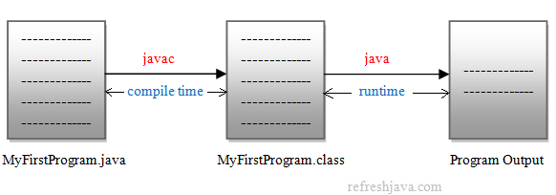
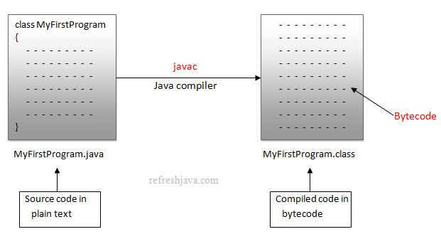
Creating and Compiling Programs
On command line
javac MyFirstProgram.java
‹#›

Slide 22
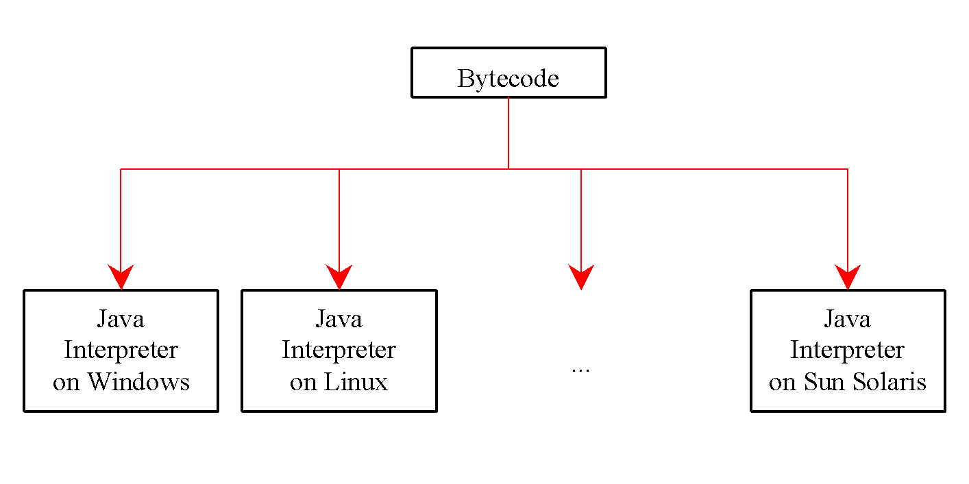
Executing Applications
On command line
java classname
‹#›

Slide 23
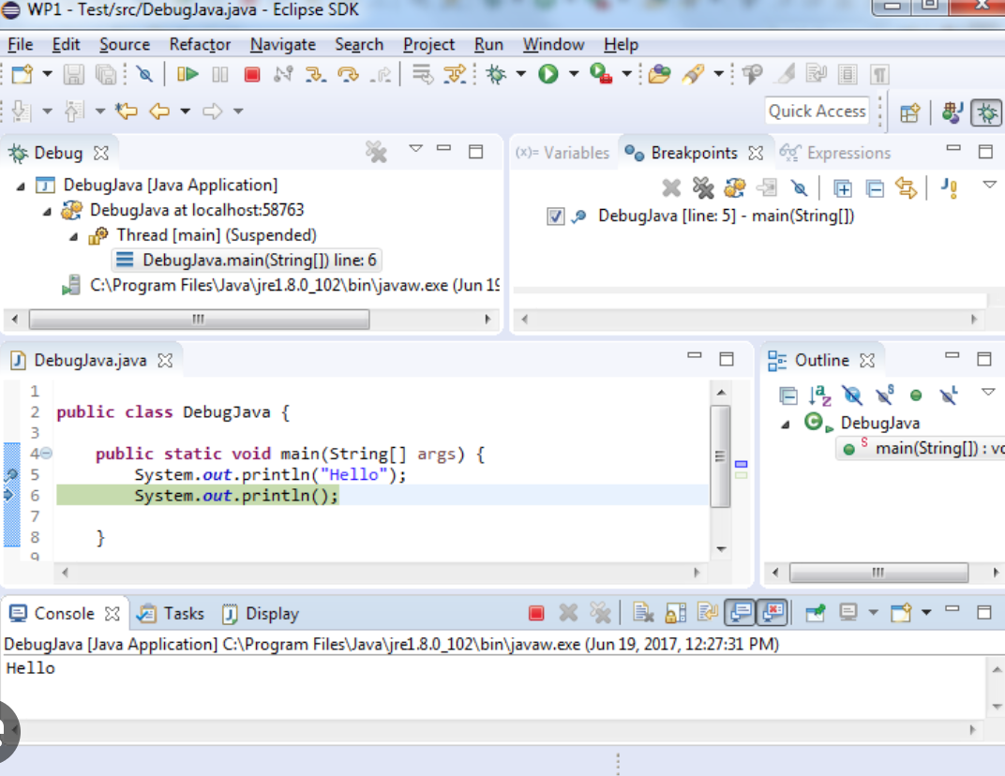
Debugging - catch those bugs

Slide 24
Compiling and Running a Program
javac MyFirstProgram.java
java MyFirstProgram
output:...
‹#›

Slide 25
Anatomy of a Java Program
Comments
Package
Reserved words
Modifiers
Statements
Blocks
Classes
Methods
The main method
‹#›

Slide 26
Comments
In Java, comments are preceded by two slashes (//) in a line, or
enclosed between /* and */ in one or multiple lines.
When the compiler sees //, it ignores all text after // in the same line. When it sees /*, it scans for the next */ and ignores any text between /* and */.
‹#›

Slide 27
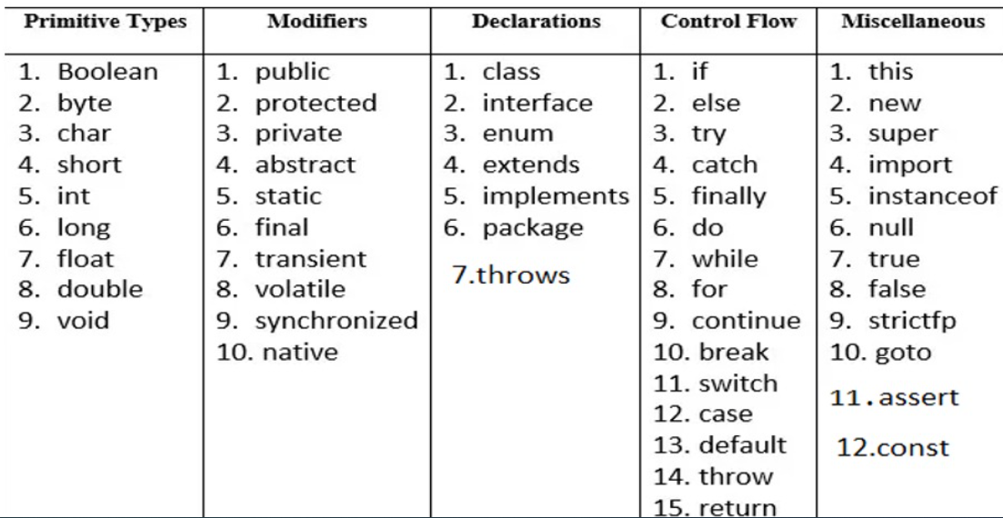
Reserved Words - Keywords
Keywords are words that have a specific meaning to the compiler and cannot be used for other purposes in the program.
For example, when the compiler sees the word class, it understands that the word after class is the name for the class. Other reserved words in Example are public, static, and void.
‹#›

Slide 28
Package
The first line in the program (package com.basic;) specifies a package name, com.basic, for the class Welcome.
IDE compiles the source code in Welcome.java, generates Welcome.class, and stores Welcome.class in the com/basic folder.
‹#›

Slide 29
Modifiers
Java uses certain reserved words called modifiers that specify the properties of the data, methods, and classes and how they can be used.
Examples of modifiers are public and static.
Other modifiers are private, final, abstract, and protected.
A public variable, method, or class can be accessed by other programs.
A private variable or method cannot be accessed by other programs.
Modifiers are discussed in "Objects and Classes."
‹#›

Slide 30
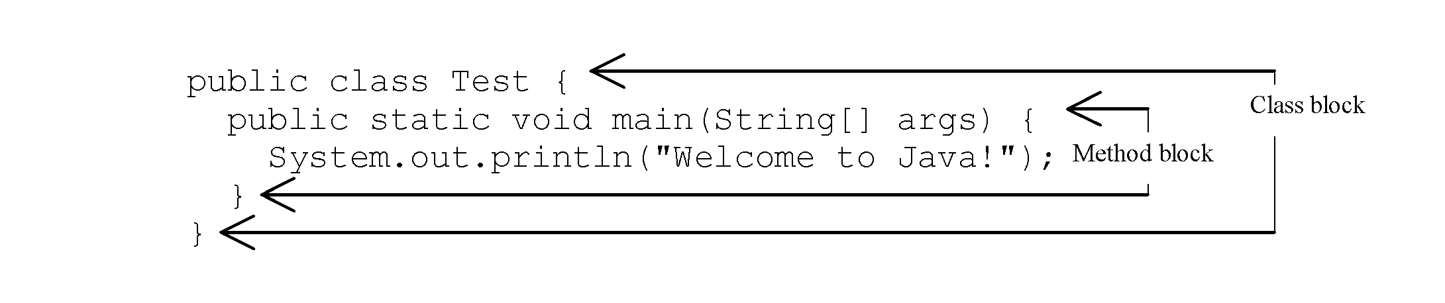
Blocks
A pair of braces in a program forms a block that groups components of a program.
‹#›

Slide 31
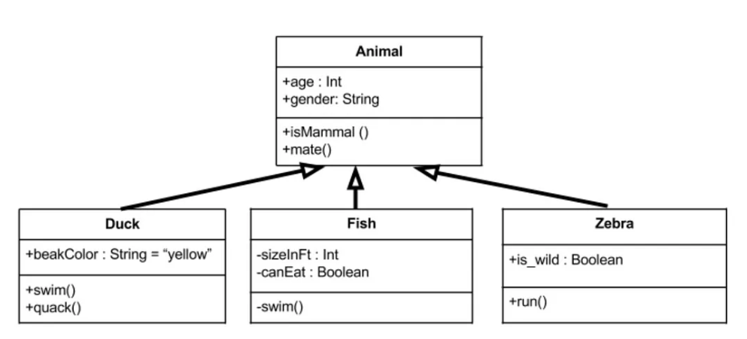
Classes
A class is a template or blueprint for objects.
To program in Java, you must understand classes and be able to write and use them.
A program is defined by using one or more classes.
‹#›

Slide 32
Methods
What is System.out.println?
It is a method: a collection of statements that performs a sequence of operations to display a message on the console.
It is used by invoking a statement with a string argument.
The string argument is enclosed within parentheses. In this case, the argument is
"Hello World!"
‹#›

Slide 33
main() Method
The main method provides the control of program flow. The Java interpreter executes the application by invoking the main method.
The main method looks like this:
public static void main(String[] args) {
// Statements;
}
‹#›

Slide 34
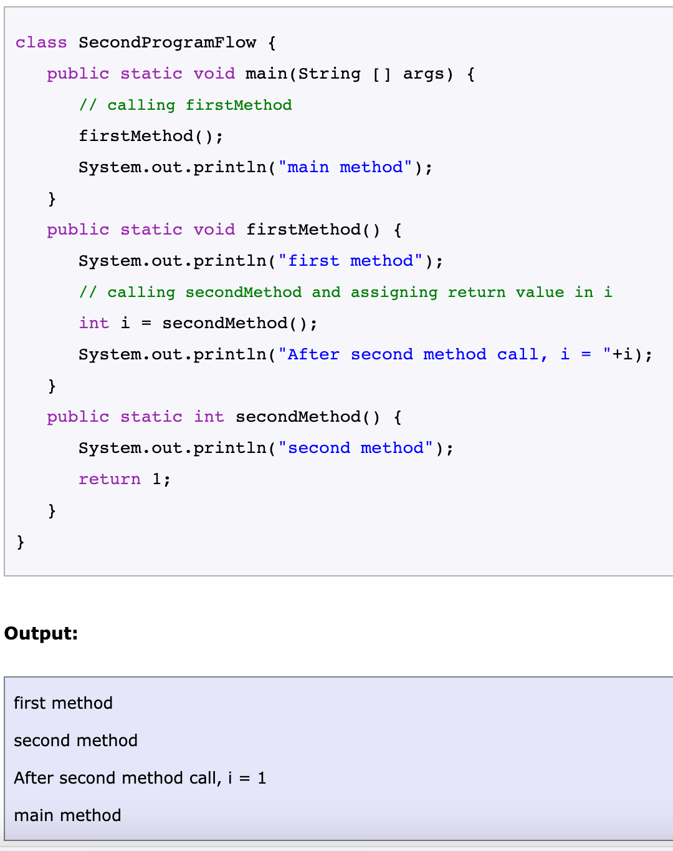
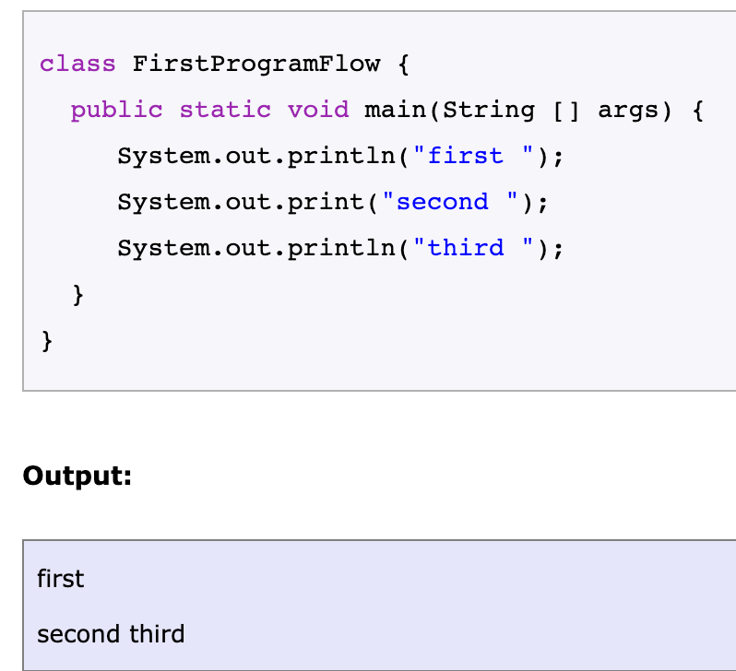
Basic Example programs

Slide 35
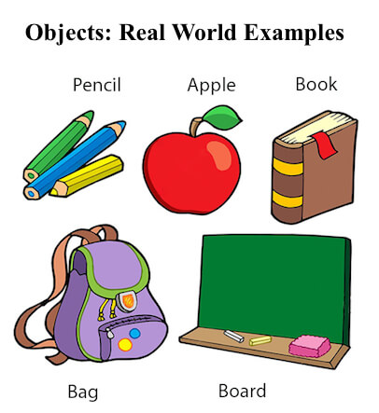
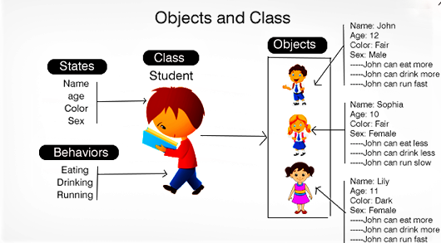
OOP concepts
1.Class
2. Objects
3. Encapsulation
4. Polymorphism
5. Inheritance
6. Abstraction

Slide 36
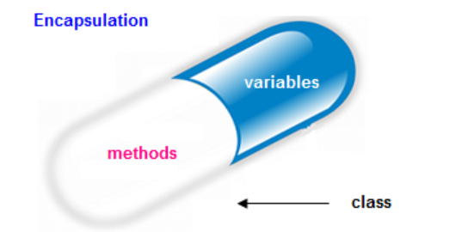
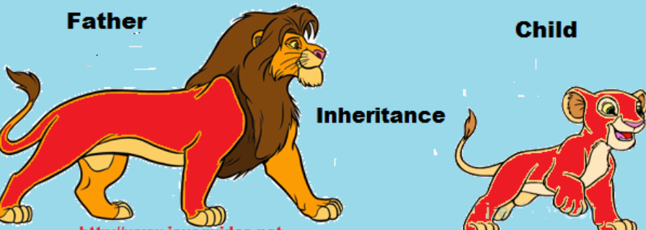

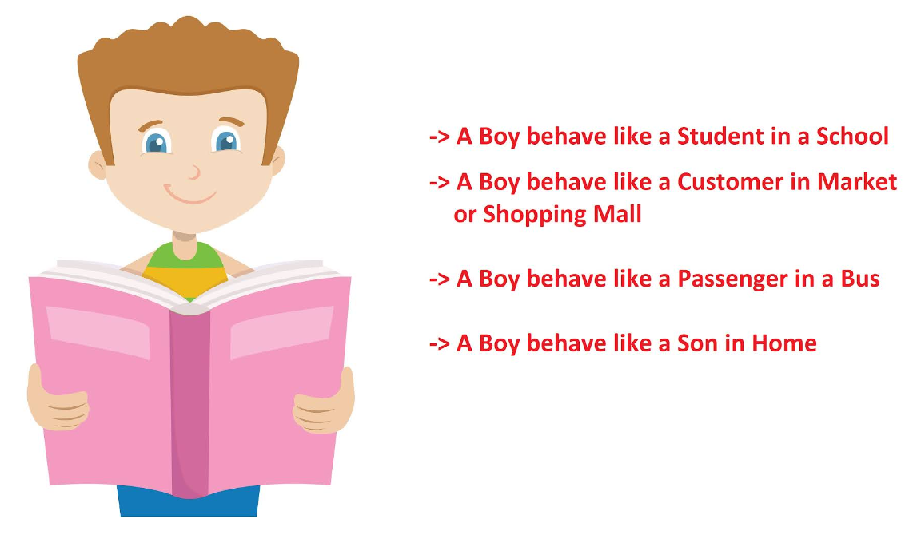
OOP
Encapsulation
Polymorphism
Inheritance
Abstraction means hiding lower-level details and exposing only the essential and relevant details to the users. In Java we use API to achieve abstraction.
Abstraction
Polymorphism

Slide 37

API
What is an API?
API stands for "Application Programming Interface." It's like a set of rules and tools that allows different software applications to communicate and work together. Think of it as a bridge that enables different programs to talk to each other and share information.
What is the Java API?
The Java API is a collection of pre-built tools, functions, and instructions that comes with the Java programming language. It's like a big library filled with useful code that developers can use in their own programs. Instead of reinventing the wheel and writing everything from scratch, developers can use the Java API to save time and effort.
How does the Java API work?
Let's say you want to perform a specific task in your Java program, like reading a file or connecting to the internet. Instead of writing all the code yourself, you can use the Java API to do it for you. You simply call the right tool from the Java API, and it will handle the task behind the scenes. It's like having a helper who knows how to do things faster and better than you!
Example of using the Java API: Imagine you want to print something on the screen in Java. Instead of writing complex code to manage the screen display, you can use a simple line of code like this

Slide 38
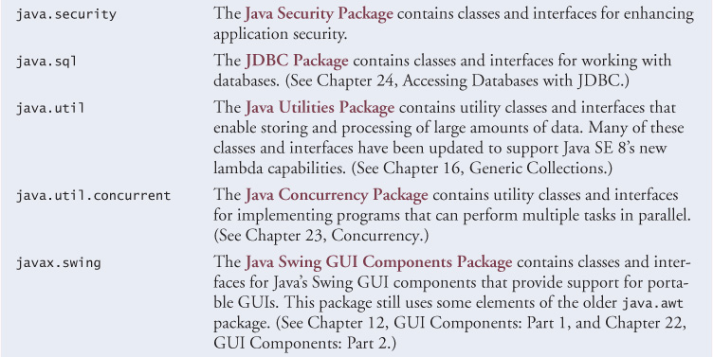
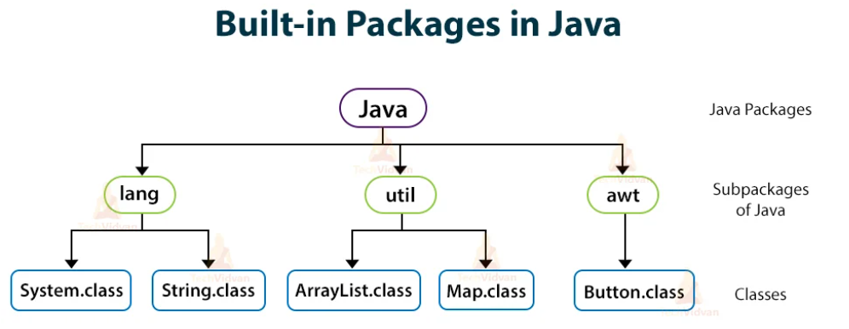
Java API

Slide 39
Interview questions (Basic)
Explain working of Java Virtual Machine (JVM)?
Expain the reason for each keyword of public static void main(String args[])?
Describe the principles of OOPS.
Name primitive Java types.
What are Java Access modifiers?
What is the difference between public, private, protected and default Access Specifiers?
What is an API ?
More questions : https://www.interviewbit.com/java-interview-questions/#freshers

Slide 40
References
Public domain links
https://www3.ntu.edu.sg/home/ehchua/programming/java/j2_basics.html
https://refreshjava.com/java/java-introduction
Real world examples https://medium.com/@techGrid/oops-concepts-in-java-with-real-time-examples-1e8110a76462
https://www.javaguides.net/2019/08/oops-concepts-in-java-with-realtime-examples.html
Books
Head first Java - orielly
Java complete reference
Internet

Slide 41
FAQ

